Slide 1



: A Faithful and Scalable
Testbed for Mobile UI Task Automation
Li Zhang, Shihe Wang, Xianqing Jia, Zhihan Zheng, Yunhe Yan, Longxi Gao, Yuanchun Li#, Mengwei Xu
Beijing University of Posts and Telecommunications (BUPT) #Institute for AI Industry Research (AIR), Tsinghua University

Slide 2

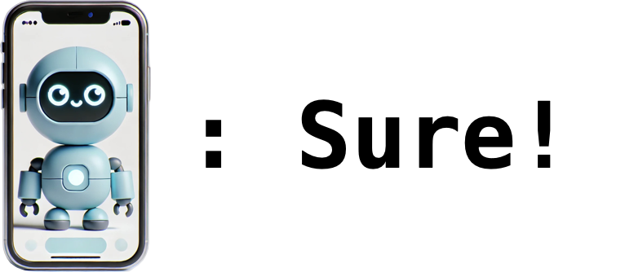
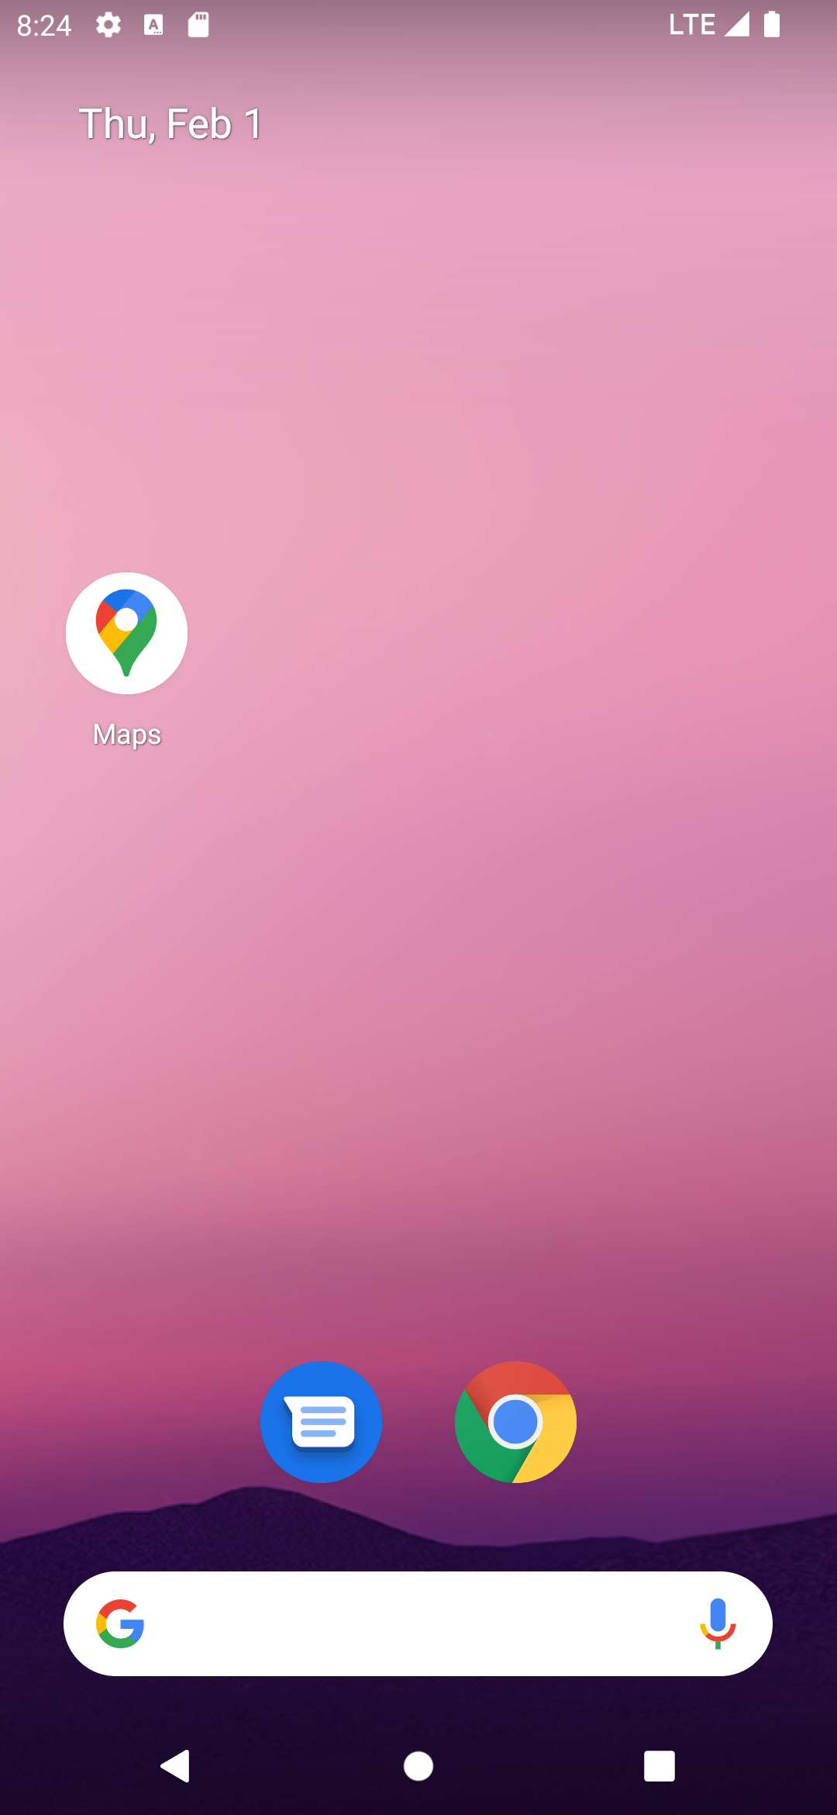
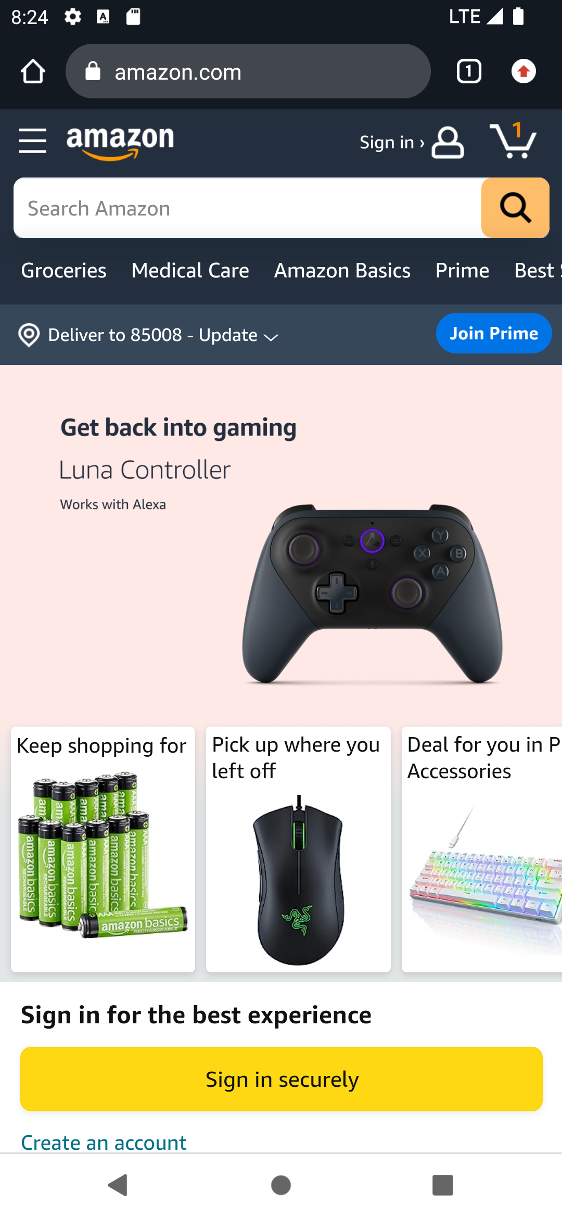
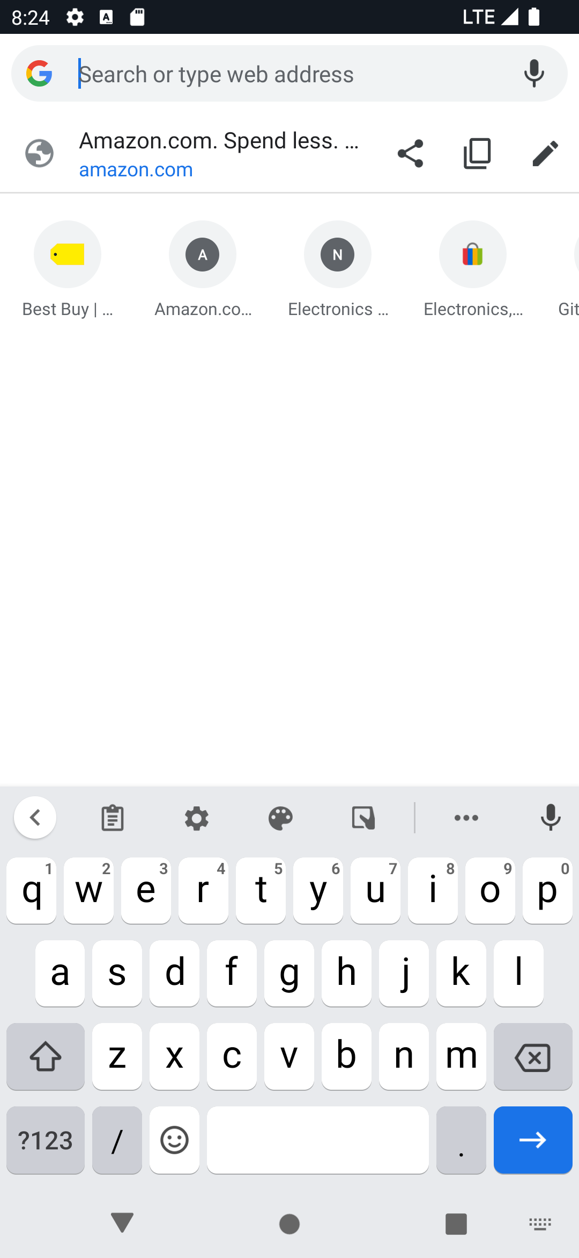
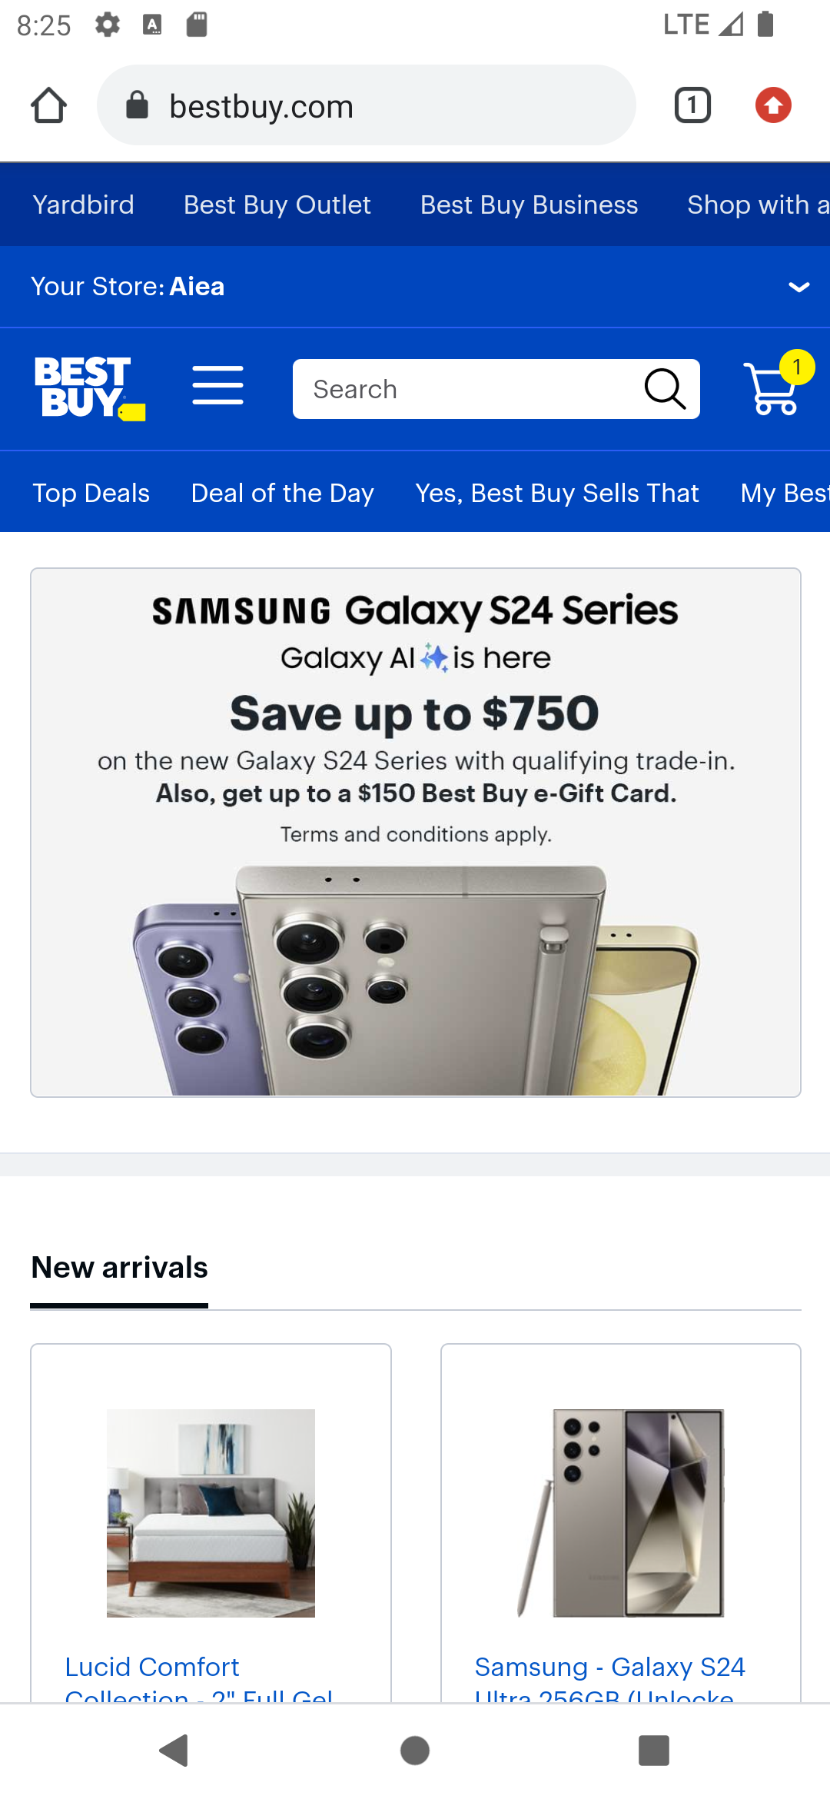
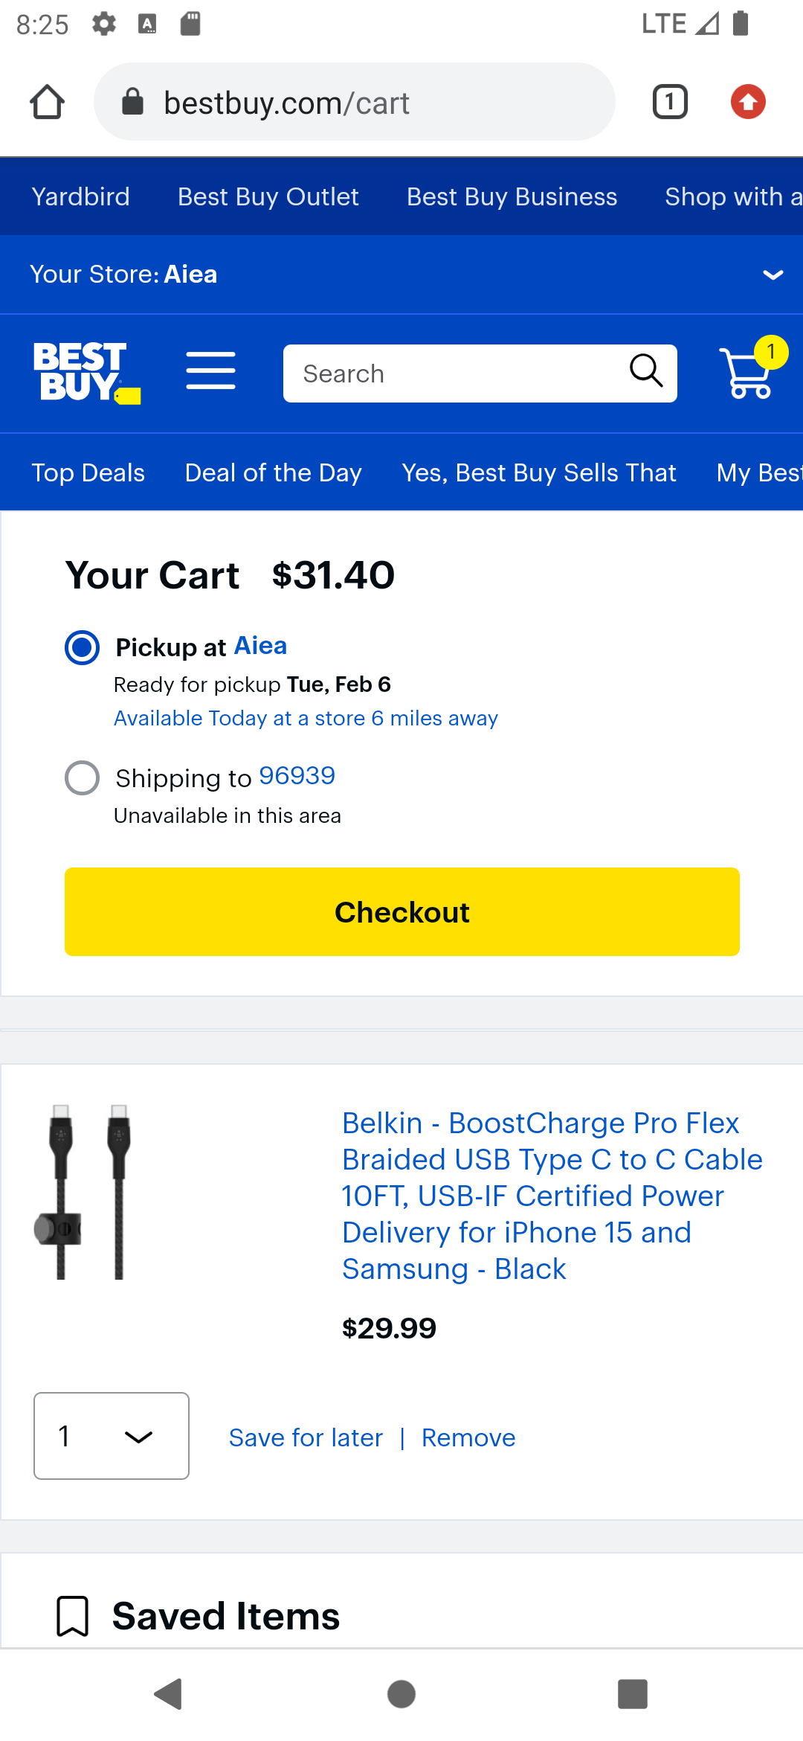
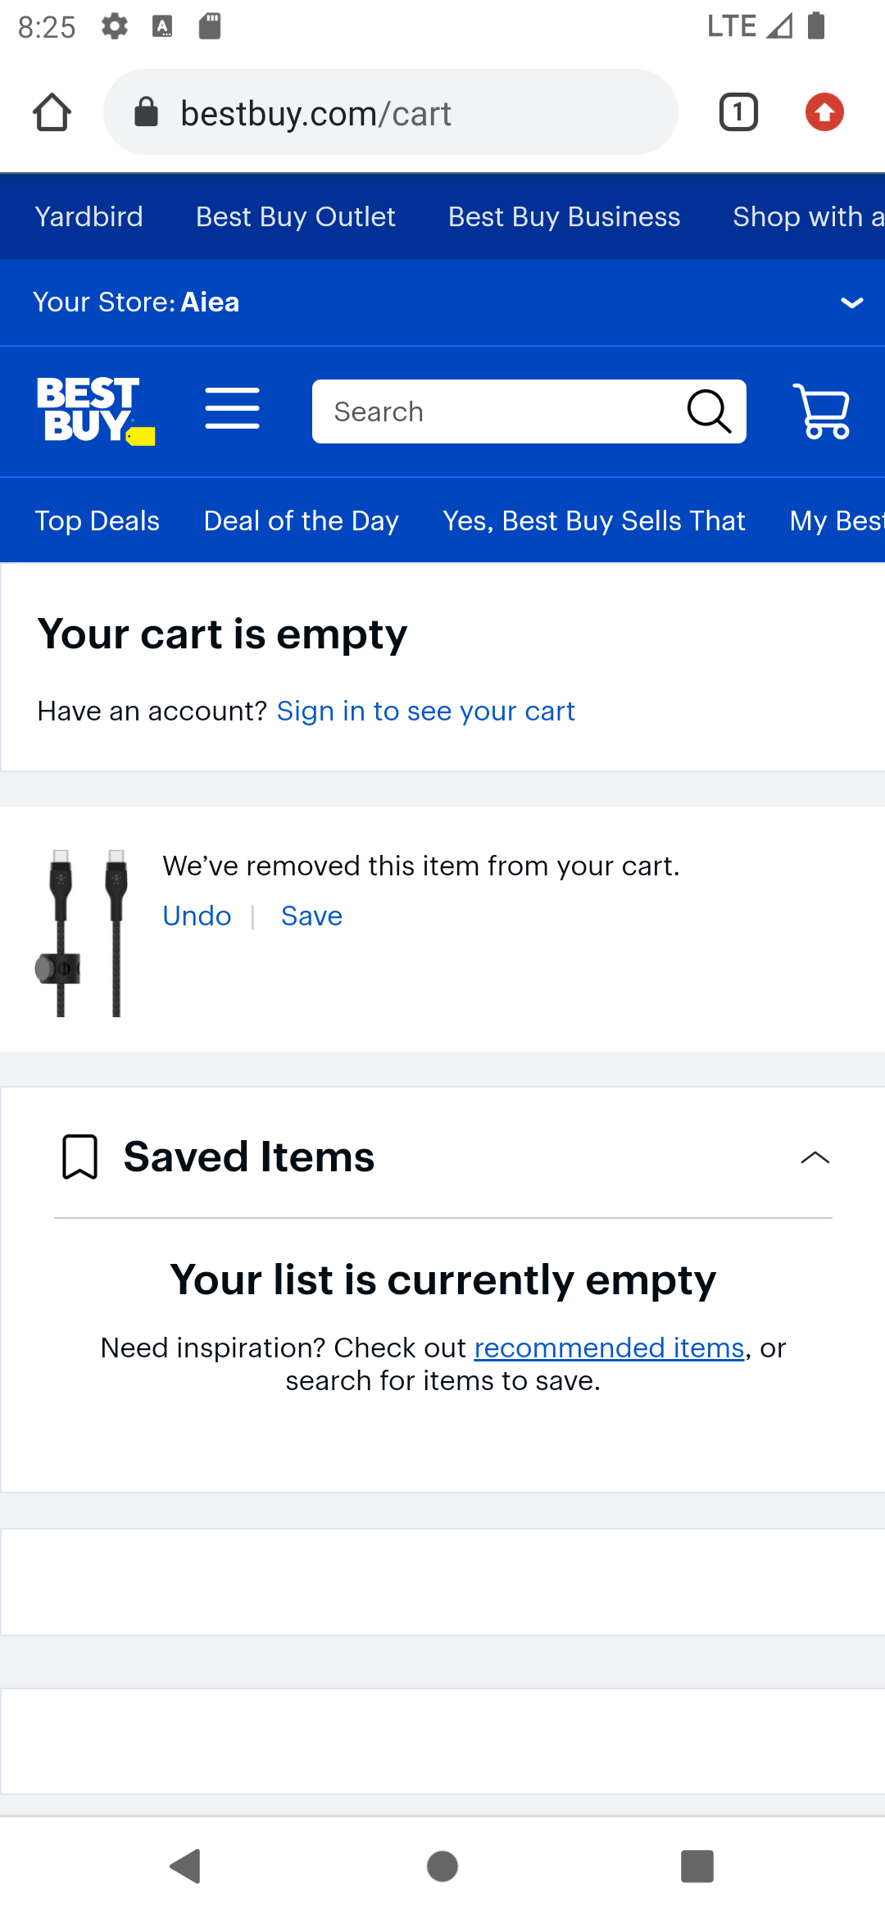






Mobile UI Task Automation
Task Complete

Slide 3
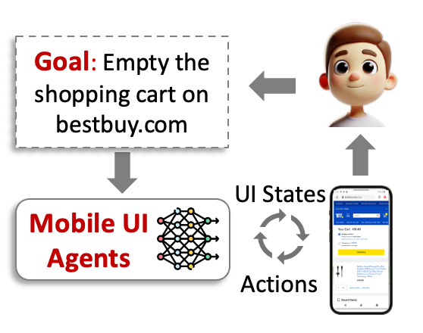




LLM/MLLM-powered Mobile UI Agents
LLM/MLLMs for Mobile UI Perception and Action Prediction
Support

Slide 4


LLM/MLLM-powered Mobile UI Agents
LLM/MLLMs for Mobile UI Perception and Action Prediction
Task Execution Traces
Action
Action
Action
Action
Action
Support
Can these agents accurately complete user requests?

Slide 5

Evaluating Mobile UI Agents
Task Execution Traces
Action
Action
Action
Action
Action
High accuracy
Approach #1: Human validation
Low scalability
High cost

Slide 6






Evaluating Mobile UI Agents
Task Execution Traces
Action
Action
Action
Action
Action
Action Type ✅
Action Type ✅
Action Type ✅
Ground-truth UI Traces in Static Datasets
Action Param ✅
Action Param
Action Param ✅
Action
Action
Action
Action
Action
Action
Action
Action

Slide 7

Evaluating Mobile UI Agents
Task Execution Traces
Approach #2: Step-wise action match on static datasets
Action
Action
Action
Action
Action
High scalability
Low accuracy
Action Type ✅
Action Type ✅
Action Type ✅
Ground-truth UI Traces in Static Datasets
Action Param ✅
Action Param
Action Param ✅
Many potential paths to finish a task that cannot be covered by static action sequences.
Action
Action
Action
Action
Action
Action
Action
Action

Slide 8
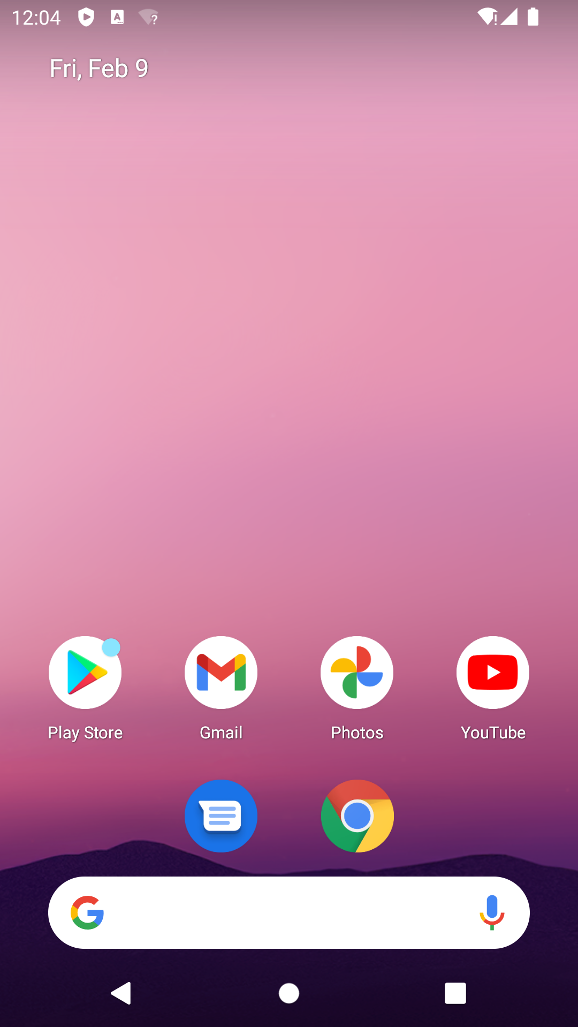
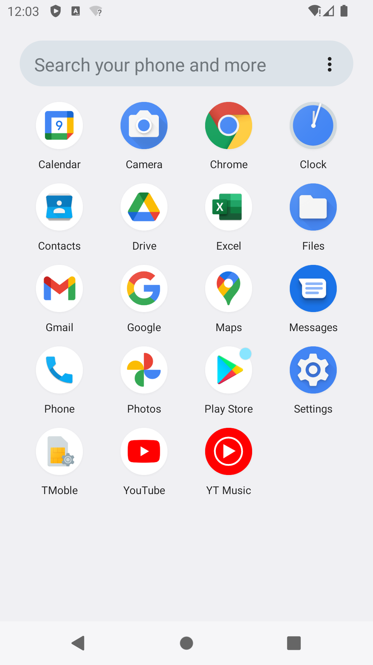
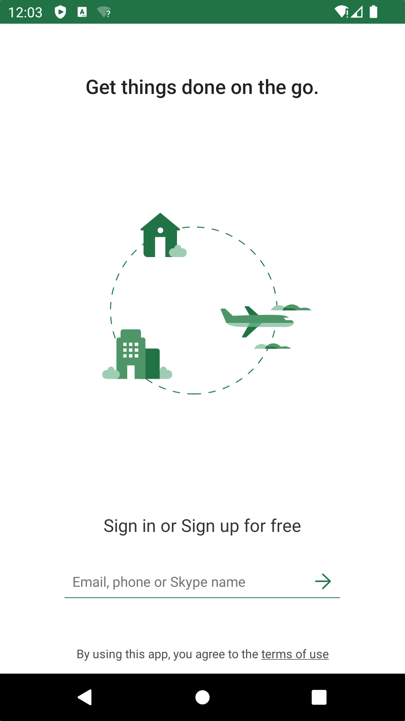
Observation
Target: Scalable (as evaluated on static datasets) and faithful (as evaluated by humans) evaluation
Observation: UI automation tasks transfer app states represented on the screen.
Task: Open app "Microsoft Excel" (install if not already installed), go to the login page

Slide 9
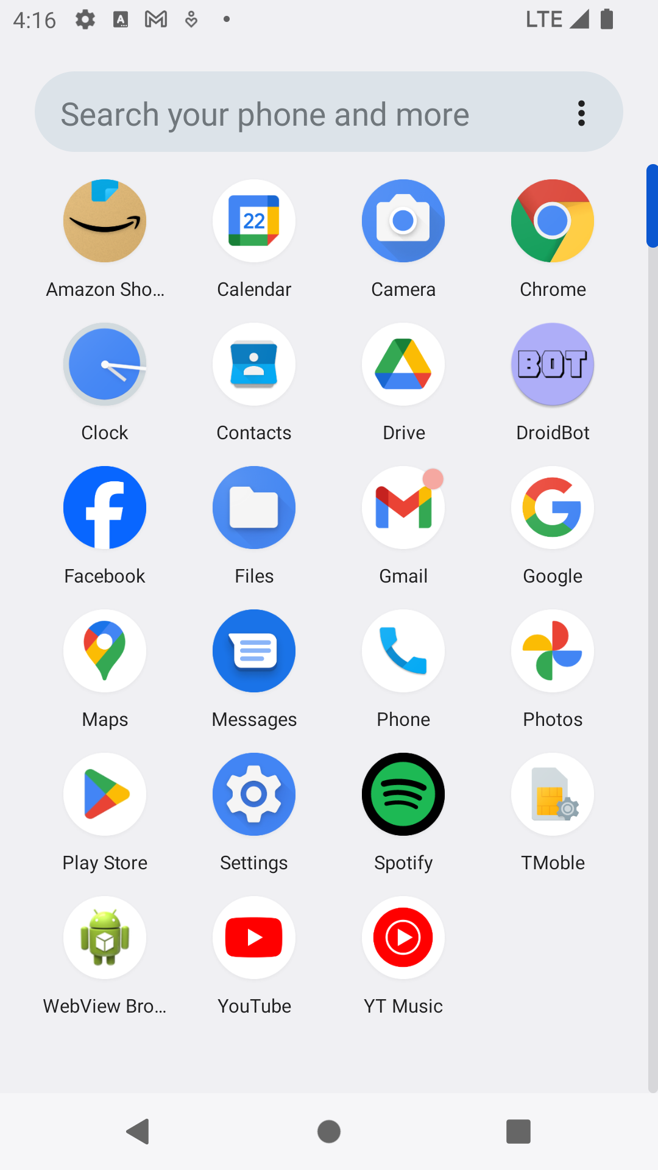
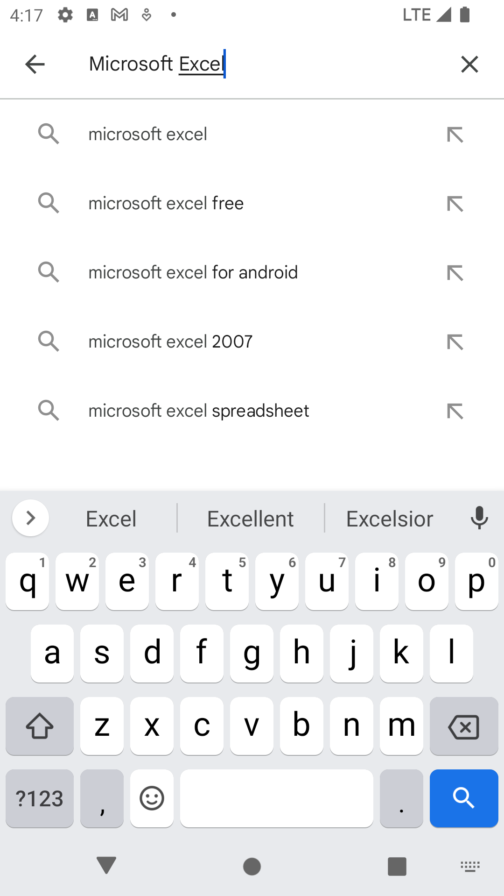
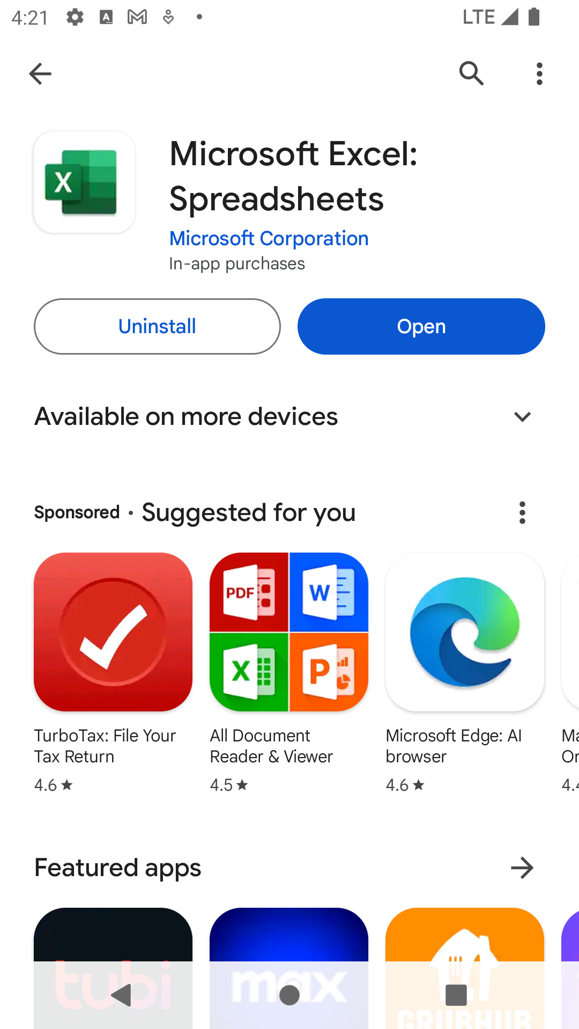
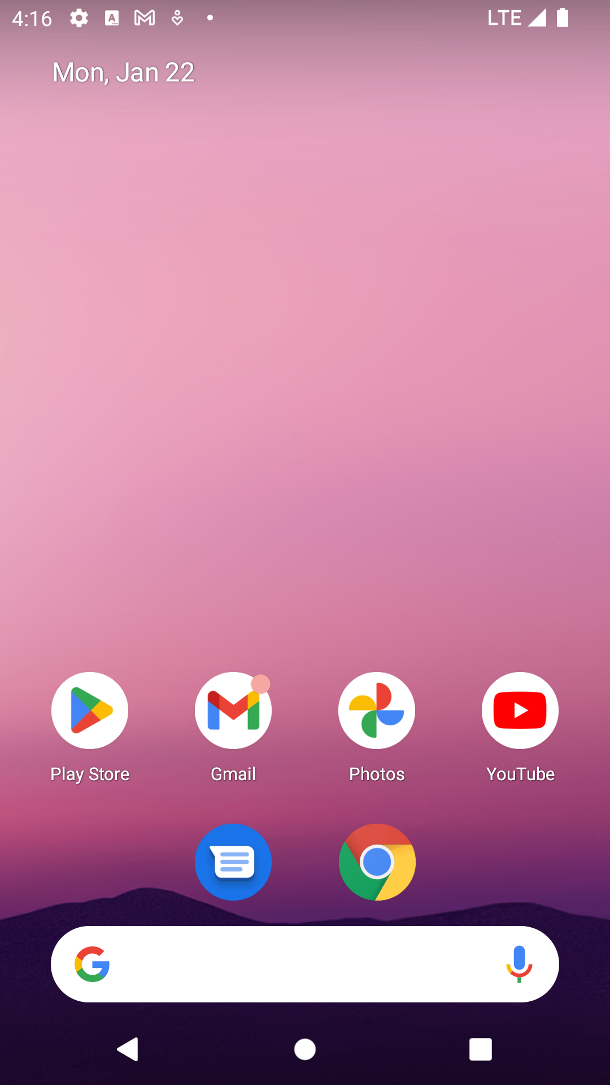
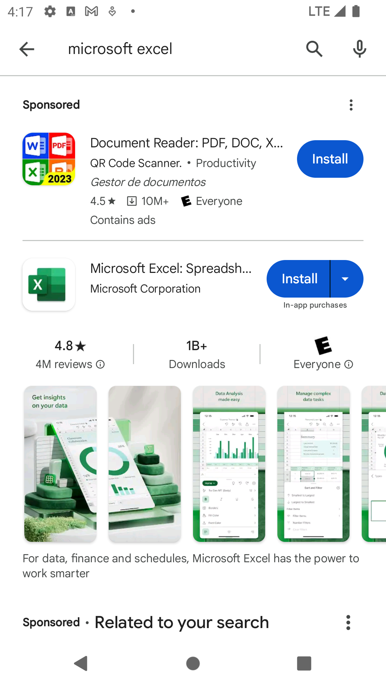
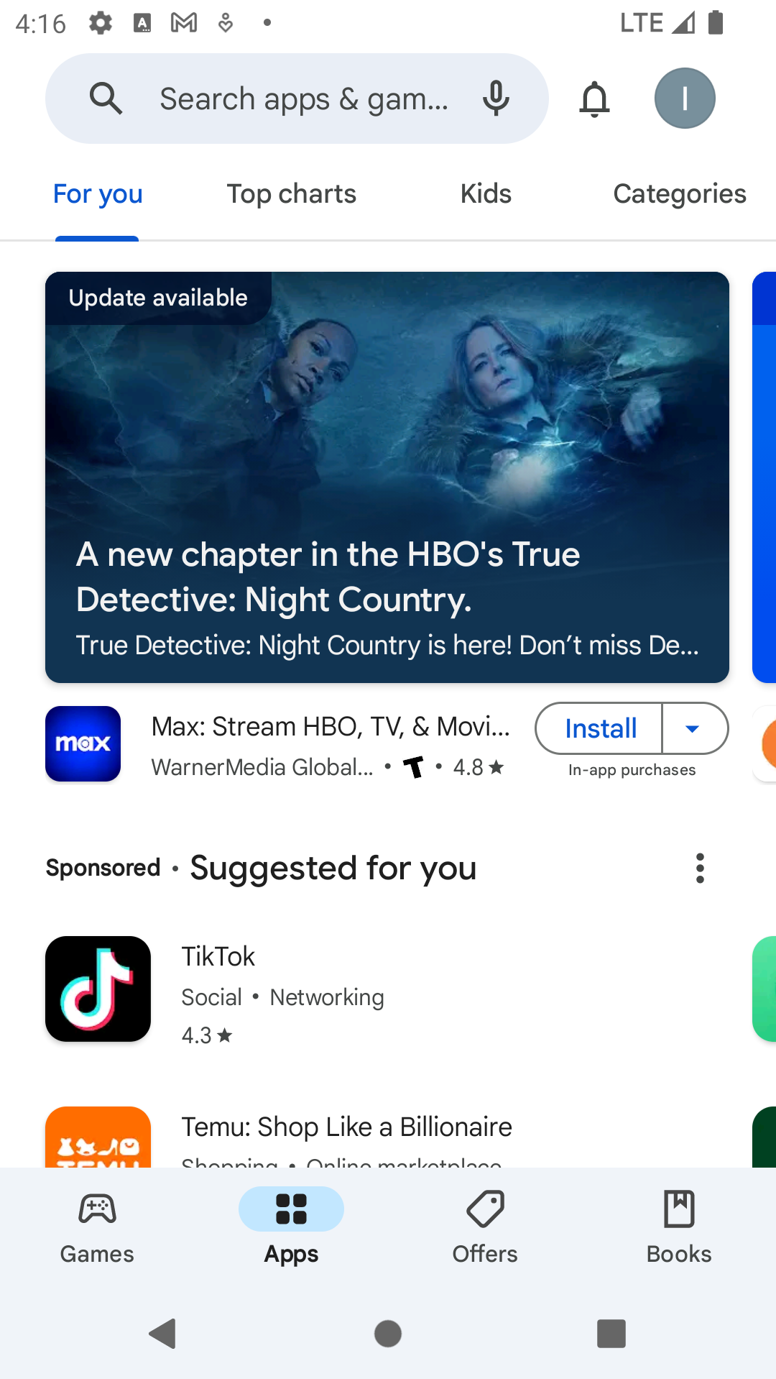
Observation
Target: Scalable (as evaluated on static datasets) and faithful (as evaluated by humans) evaluation
Observation: UI automation tasks transfer app states represented on the screen.
Task: Open app "Microsoft Excel" (install if not already installed), go to the login page
Task: Open app "Microsoft Excel" (install if not already installed), go to login, …

Slide 10
Observation
Different task execution paths
The same app state
The login page of Microsoft Excel
Task: Open app "Microsoft Excel" (install if not already installed), go to login, …

Slide 11
Our Approach
Our approach: Check app states during and after task execution, rather than comparing concrate action sequences.
For a given task, how to annotate app states to represent task completion?

Slide 12
Task Completion Annotation
Annotate and match at the whole-screen level
Unable to handle dynamic screen resolutions, dynamic screen contents (e.g., ads)

Slide 13
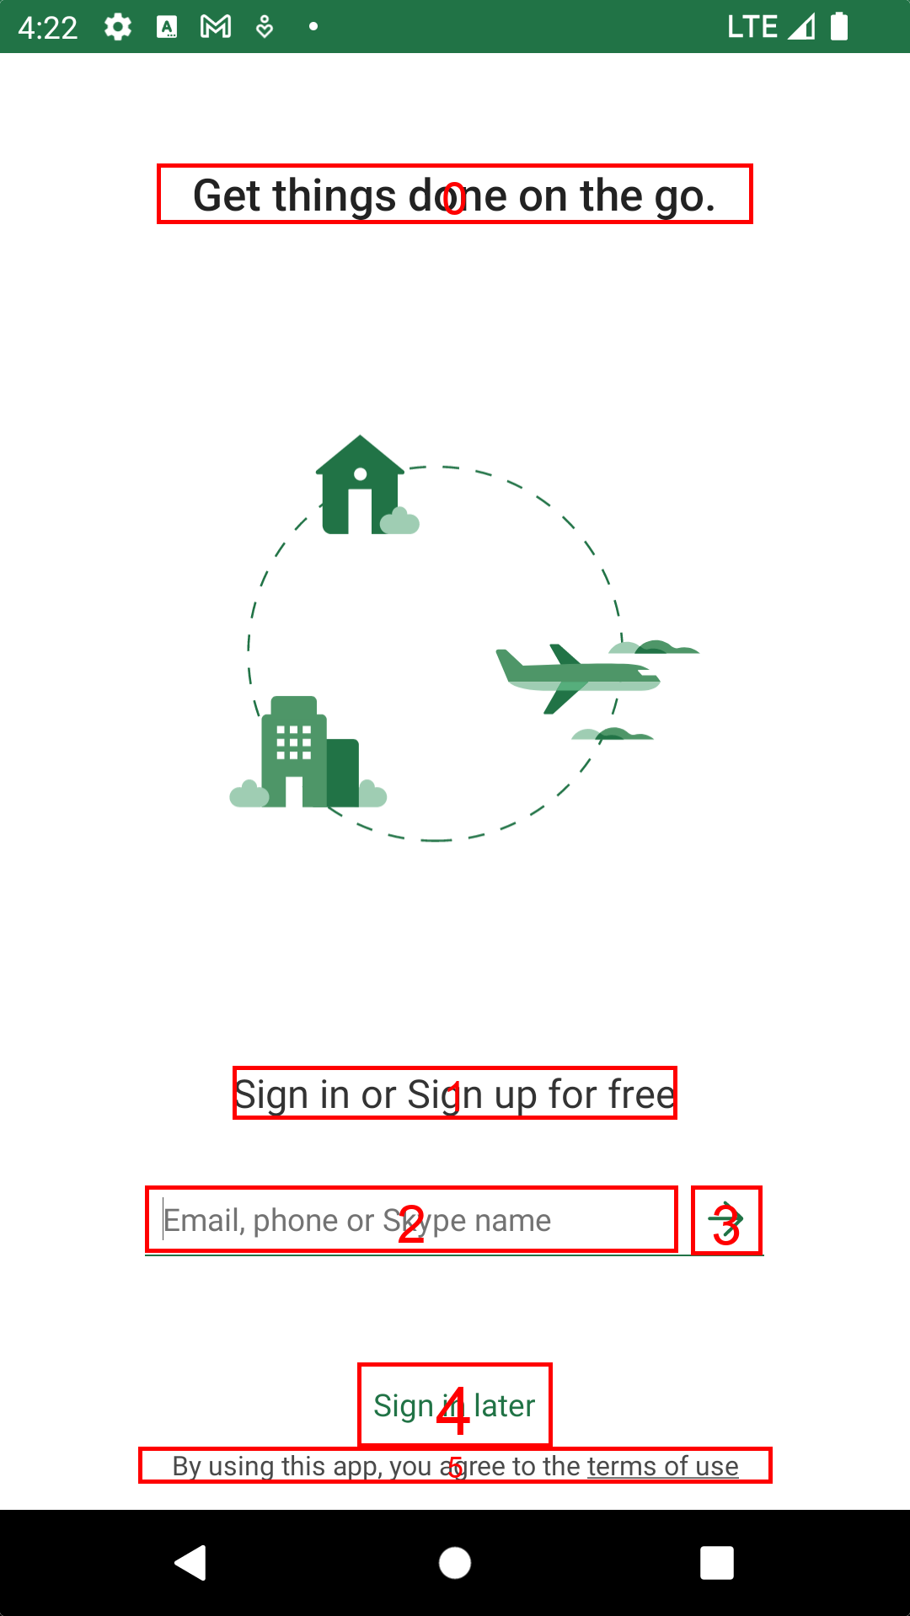
Task Completion Annotation
Annotate and match at the whole-screen level
What we want: Fine-grained app state annotation
Unable to handle dynamic screen resolutions, dynamic screen contents (e.g., ads)

Slide 14
Task Completion Annotation
Annotate and match at the whole-screen level
What we want: Fine-grained app state annotation
Unable to handle dynamic screen resolutions, dynamic screen contents (e.g., ads)
The whole screen -> single UI components
Annotate those only essential ones

Slide 15
Task Completion Annotation
The most straightforward approach: Annotate and match at the whole-screen level
Unable to handle dynamic screen resolutions, dynamic screen contents (e.g., ads)
What we want: fine-grained app state annotation
Breakdown the whole screen into individual UI components
Annotate only those essential states

Slide 16
Task Completion Annotation: Examples
Task: Empty the shopping cart on BestBuy

Slide 17
Task Completion Annotation: Examples
Task: Empty the shopping cart on BestBuy
Exact match on the URL field: “bestbuy.com/cart”
Exact match on the UI component with text “Your cart is empty”
All others (actions, UI components) are omitted.

Slide 18
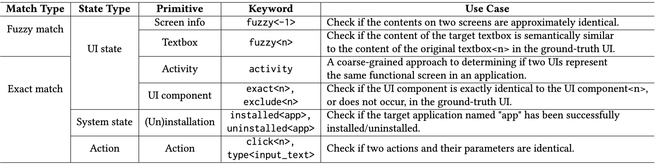
Annotation Primitives
Two types of matching design: Exact match and fuzzy match
Annotation at different granularity: The whole screen, individual UI components, system states, actions, etc.
Implementation of corresponding match logic of these primitives during evaluation

Slide 19
Streamline the Annotation Process
Requirements: A mobile UI automation dataset, each data item including screeshot, view hierarchies, and task description
Filter important UI components, then overlay numeric IDs of these components on screenshots.
Display the trace on a web platform to reduce annotation effort

Slide 20
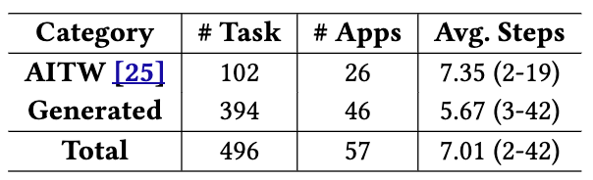
LlamaTouch Dataset
Dataset scale: 496 tasks
102 from Android-in-the-Wild* with essential state annotated
394 new-constructed ones, covering diverse daily apps; annotate from stratch
*Rawles, Christopher, et al. "Android-in-the-wild: A large-scale dataset for android device control.” NeurIPS 2024.

Slide 21
LlamaTouch Dataset
Dataset scale: 496 tasks
102 from Android-in-the-Wild* with essential state annotated
394 new-constructed ones, covering diverse daily apps; annotate from stratch
Data: Each task includes
Screen representations: Pixel-level screeshots, view hierarchies, Android activities
Actions on each screen
Task instructions
Annotated essential states
Task setup: A global Android emulator image (with installed apps), and env setup scripts
*Rawles, Christopher, et al. "Android-in-the-wild: A large-scale dataset for android device control.” NeurIPS 2024.

Slide 22
On-device Task Execution
UI automation task in real-world environments
Rather than predicting actions on static datasets
Realistic Mobile Environments

Slide 23
On-device Task Execution
UI automation task in real-world environments
Rather than predicting actions on static datasets
AgentEnv: A list of APIs to bridge mobile UI agents and real-world mobile environments
Mobile Agents
Actions & Device States
AgentEnv
Actions & Device States
Realistic Mobile Environments

Slide 24
Offline Trace Evaluation
Task execution traces are automatically logged by AgentEnv
Mobile Agents
Actions & Device States
AgentEnv
Agent Exec Traces
Actions & Device States
Realistic Mobile Environments

Slide 25
Offline Trace Evaluation
Task execution traces are automatically logged by AgentEnv
LlamaTouch Evaluator: Compare task execution traces with predefined essential states in LlamaTouch Dataset
Mobile Agents
LlamaTouch Dataset
Actions & Device States
AgentEnv
Agent Exec Traces
Actions & Device States
Evaluation
Realistic Mobile Environments
Step-wise action match
LCS-based action match
LlamaTouch Evaluator

Slide 26
Putting Them Together
Code Demo for Mobile UI Task Execution
LlamaTouch Workflow
Code Demo for Trace Evaluation
# agent/environment setup
agent = mobile_agent.init() # agent initialization
task = agentenv.task.get() # get task metadata
agentenv.setup_task(task) # task-specific setup
# task execution
while not agent.task_complete():
state = agentenv.get_state()
act = agent.predict(task, state.screenshot, state.vh) # predict action on current UI based on task instruction and observed UI states
agentenv.post(act) # post action to device
Mobile Agents
LlamaTouch Dataset
# A mobile agent class with trace loader implementation
class MobileAgent:
def load_agent_exec_traces(task):
# agent execution trace loader
# run evaluation
agent = MobileAgent()
evaluator = LlamaTouchEvaluator(agent)
evaluator.run_evaluation()
Actions & Device States
AgentEnv
Agent Exec Traces
Actions & Device States
Evaluation
Realistic Mobile Environments
Step-wise action match
LCS-based action match
LlamaTouch Evaluator
Task Completion Rate; Accuracy; etc.
LlamaTouch is easy to use.
Integrate mobile UI agents to AgentEnv
Implement trace evaluation logic

Slide 27
Evaluation Setup
Key question: Can LlamaTouch evaluate mobile UI agents with high faithfulness?
Metric: Accuracy of evaluation methods
Taking human validation results as the ground truth
Baselines: Two action match-based evaluation methods on static datasets
Step-wise action match (require two action sequences are identical)
Longest common subsequence (LCS)-based action match* (add non-essential actions tolerance between ground-truth actions)
Mobile UI agents: AutoDroid (GPT-4, MobiCom’24), Auto-UI (customized model, ACL’24), CoCo-Agent (LLaVa, ACL’24), AppAgent (GPT-4o)
*Xing, Mingzhe, et al. "Understanding the weakness of large language model agents within a complex android environment." SIGKDD 2024.

Slide 28
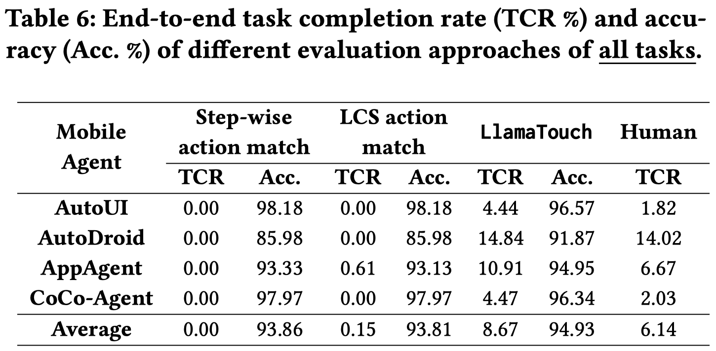
Results from All Tasks

Slide 29
Results from All Tasks
Action-match methods failed to evaluate tasks (with an almost 0% task completion rate).

Slide 30
Results from All Tasks
Action-match methods failed to evaluate tasks (with an almost 0% task completion rate).
LlamaTouch reports task completion rates closer to human validation (e.g., 8.6 vs. 6.1).

Slide 31
Results from All Tasks
Action-match methods failed to evaluate tasks (with an almost 0% task completion rate).
LlamaTouch reports task completion rates closer to human validation (e.g., 8.6 vs. 6.1).
All methods show high accuracy as there are most false cases: UI agents cannot complete most requirements in real-world envs.

Slide 32
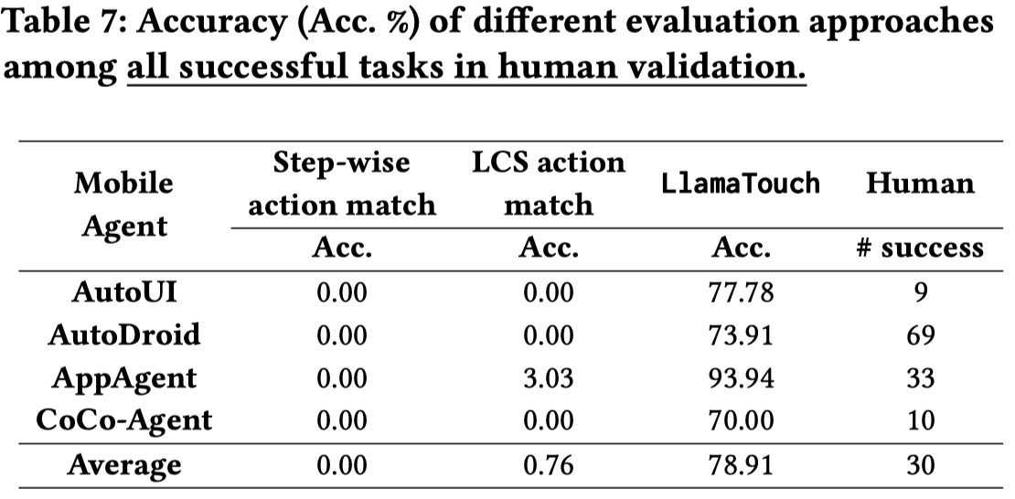
Results Completed Tasks
Among all successful tasks (validated by humans), LlamaTouch achieves nearly 80% accuracy.

Slide 33
Results Completed Tasks
Among all successful tasks (validated by humans), LlamaTouch achieves nearly 80% accuracy.
Action match approaches achieve nearly 0% accuracy.

Slide 34
Results Completed Tasks
Among all successful tasks (validated by humans), LlamaTouch achieves nearly 80% accuracy.
Action match approaches achieve nearly 0% accuracy.
LlamaTouch significantly reduces false negative cases.

Slide 35
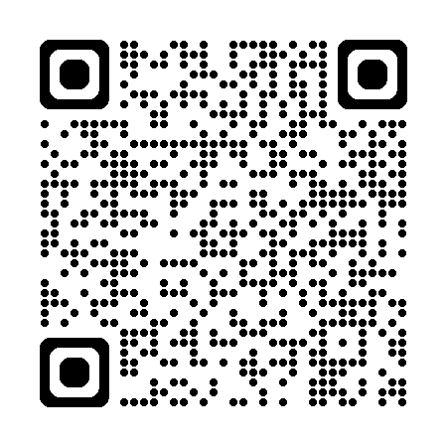

Conclusion
🤖 LlamaTouch is the first faithful and scalable testbed for mobile UI task automation.
😉 Highly extensible: New UI automation datasets, new annotation primitives, new agents, new realistic mobile environments
🤗 Fully open-sourced: Annotation platforms, dataset, LlamaTouch evaluator, mobile UI agents integrated into LlamaTouch
is available at https://github.com/LlamaTouch/LlamaTouch
li.zhang@bupt.edu.cn

